Slide 1

US Airline Delay Analysis
Python | Pandas | Seaborn | Power BI | DAX
KPI-driven analysis of airline operational efficiency, delay severity, and disruption risk (2013–2023)
Tools: Python, Excel, Power BI
Dataset: Kaggle / US airline monthly operations

Slide 2
Business Problem
Airline delays, cancellations, and diversions negatively impact operational efficiency and passenger experience. However, disruptions can arise from multiple causes such as carrier operations, weather conditions, air traffic congestion (NAS), security issues, and late-arriving aircraft. Understanding the frequency, severity and disruption drivers is essential for evaluating airline performance.

Slide 3
Project Objective
Analyse airline delay patterns over time
Understand why delays occur
Compare airline operational efficiency
Build KPIs for disruption risk
Convert raw operational data into business insights

Slide 4
Project Scope
Airline-level performance and risk analysis
Delay frequency and severity analysis
Delay cause decomposition (Carrier, Weather, NAS, Security, Late Aircraft)

Slide 5
Data & Analytical Framework
Raw Data
Feature Engineering
KPI Creation
Business Insights
Data Preprocessing
Original Metrics
Flight volume
Delay counts
Delay minutes
Cancellation/ diversion
Engineered Metrics
Delay rate
Delay severity
Delay composition
Disruption score
Impax%
Tools
Python → cleaning & feature engineering
Power BI → dashboarding
DAX → KPI modelling

Slide 6
Data Dictionary (Original Features)
Feature Name | Definition
year | Year in which flights were recorded
Month | Month of operation (1–12)
Carrier | Airline code identifier
carrier_name | Full airline name
Airport | Airport IATA code
airport_name | Full airport name and location
arr_flights | Total arriving flights
arr_cancelled | Total cancelled flights
arr_diverted | Total diverted flights
arr_del15 | Flights delayed by 15+ minutes
arr_delay | Total arrival delay minutes
carrier_ct | Delayed flights caused by airline operations
weather_ct | Delayed flights caused by weather
nas_ct | Delays caused by National Airspace System congestion
security_ct | Delays caused by security issues
late_aircraft_ct | Delays caused by late incoming aircraft
carrier_delay | Total airline-caused delay minutes
weather_delay | Total weather-caused delay minutes
nas_delay | Total NAS delay minutes
security_delay | Total security delay minutes
late_aircraft_delay | Total late aircraft delay minutes

Slide 7
Delay Types and their causes
Carrier Delay
Late Aircraft Delay
NAS (National Aviation System) Delay
Security Delay
Weather Delay
Airline operational issues
Aircraft arriving late from previous flight
Air traffic congestion
Security issues
Extreme weather events

Slide 8
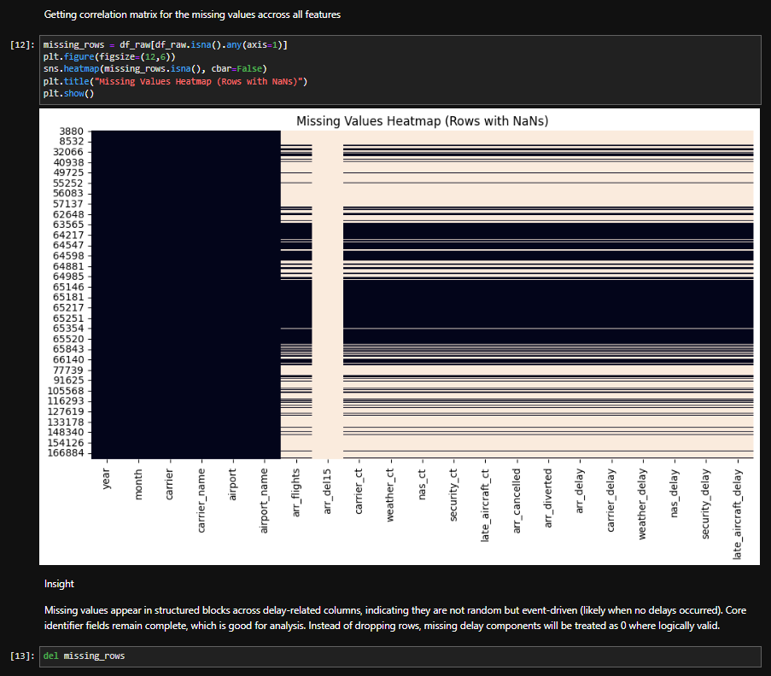
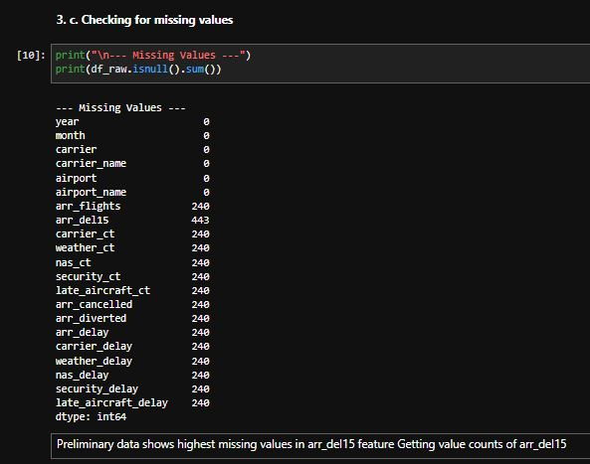
Data Preprocessing
Missing rows deleted
Code output clearly shows 240 rows with missing values in the numeric columns.
All 240 rows were dropped.

Slide 9
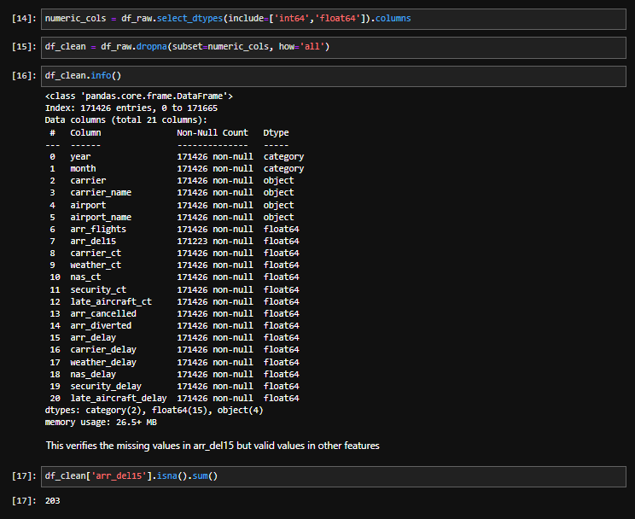
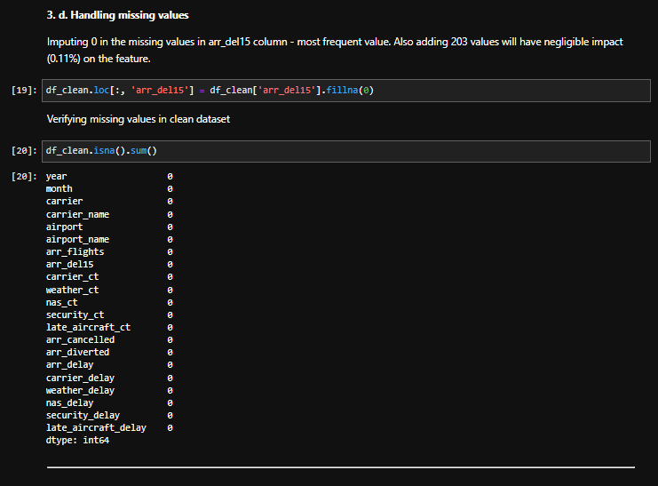
Data Preprocessing
Missing value imputation
203 rows in arr_del15 still remained empty.
They were imputed with constant value 0, implying no delay.

Slide 10
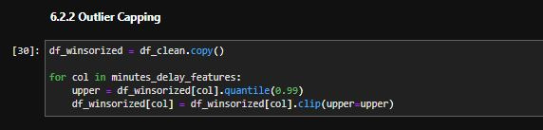
Data Preprocessing
Extremely right skewed delay features presence detected with boxplot and distribution plot itself.
Only delay features were considered for outlier capping to prevent extreme spikes.
Rest all values kept as is - business signal.

Slide 11
Data Dictionary (Engineered Features)
Feature Name | Formula / Definition
Airline_group | Short name for airline
delay_rate | arr_delay ÷ arr_flights
cancel_rate | arr_cancelled ÷ arr_flights
divert_rate | arr_diverted ÷ arr_flights
carrier_delay_share | carrier_delay ÷ arr_delay
weather_delay_share | weather_delay ÷ arr_delay
nas_delay_share | nas_delay ÷ arr_delay
security_delay_share | security_delay ÷ arr_delay
late_aircraft_delay_share | late_aircraft_delay ÷ arr_delay
carrier_delay_freq | carrier_ct ÷ arr_flights
weather_delay_freq | weather_ct ÷ arr_flights
nas_delay_freq | nas_ct ÷ arr_flights
security_delay_freq | security_ct ÷ arr_flights
late_aircraft_delay_freq | late_aircraft_ct ÷ arr_flights
delay_frequency | arr_del15 ÷ arr_flights
carrier_avg_delay | carrier_delay ÷ carrier_ct
weather_avg_delay | weather_delay ÷ weather_ct
nas_avg_delay | nas_delay ÷ nas_ct
security_avg_delay | security_delay ÷ security_ct
late_aircraft_avg_delay | late_aircraft_delay ÷ late_aircraft_ct
avg_delay_per_delayed_flight | arr_delay ÷ arr_del15
disruption_score | Weighted operational disruption metric
severe_delay_flag | Flags delays exceeding 60 mins
severe_delay_flights | Estimated count of severe delayed flights
date | Combined year + month time feature

Slide 12
Engineered delay features
Delay Rate
Delay Frequency
Delay Share
Average Delay
Measures Delay intensity relative to flight volume.
Measures how often delays occur.
Shows contribution of each delay cause.
Measures severity of each delay event.

Slide 13
Exploratory Data Analysis
Feature | count | mean | min | 25% | 50% | 75% | max | std | median | mode | range | variance | skewness | kurtosis
arr_flights | 171426 | 362.53 | 1 | 50 | 100 | 250 | 21977 | 992.89 | 100 | 31 | 21976 | 985839.81 | 8.44 | 114.38
arr_del15 | 171426 | 66.36 | 0 | 6 | 17 | 47 | 4176 | 179.45 | 17 | 0 | 4176 | 32201.91 | 7.26 | 78.70
carrier_ct | 171426 | 20.80 | 0 | 2.16 | 6.4 | 17.26 | 1293.91 | 50.32 | 6.4 | 0 | 1293.91 | 2531.62 | 7.00 | 75.51
weather_ct | 171426 | 2.25 | 0 | 0 | 0.4 | 1.86 | 266.42 | 7.31 | 0.4 | 0 | 266.42 | 53.50 | 10.79 | 182.78
nas_ct | 171426 | 19.38 | 0 | 1 | 3.91 | 11.71 | 1884.42 | 61.68 | 3.91 | 0 | 1884.42 | 3803.84 | 8.07 | 93.77
security_ct | 171426 | 0.16 | 0 | 0 | 0 | 0 | 58.69 | 0.72 | 0 | 0 | 58.69 | 0.51 | 15.12 | 576.47
late_aircraft_ct | 171426 | 23.77 | 0 | 1.23 | 5 | 15.26 | 2069.07 | 72.39 | 5 | 0 | 2069.07 | 5240.82 | 7.84 | 90.10
arr_cancelled | 171426 | 7.53 | 0 | 0 | 1 | 4 | 4951 | 43.65 | 1 | 0 | 4951 | 1905.75 | 33.55 | 2079.00
arr_diverted | 171426 | 0.86 | 0 | 0 | 0 | 1 | 197 | 3.77 | 0 | 0 | 197 | 14.23 | 14.55 | 340.61
arr_delay | 171426 | 3869.11 | 0 | 335 | 1018 | 2884 | 60358.75 | 9050.02 | 1018 | 0 | 60358.75 | 81902884.57 | 4.41 | 21.17
carrier_delay | 171426 | 1301.27 | 0 | 110 | 375 | 1109 | 18450.5 | 2818.51 | 375 | 0 | 18450.5 | 7944025.52 | 4.18 | 19.29
weather_delay | 171426 | 190.16 | 0 | 0 | 18 | 146 | 3282.5 | 478.52 | 18 | 0 | 3282.5 | 228981.36 | 4.44 | 22.27
nas_delay | 171426 | 795.97 | 0 | 34 | 146 | 477 | 15328.75 | 2189.10 | 146 | 0 | 15328.75 | 4792147.46 | 4.85 | 25.61
security_delay | 171426 | 5.97 | 0 | 0 | 0 | 0 | 157.75 | 22.81 | 0 | 0 | 157.75 | 520.47 | 4.95 | 26.12
late_aircraft_delay | 171426 | 1497.42 | 0 | 65 | 320 | 1070 | 25101.25 | 3722.40 | 320 | 0 | 25101.25 | 13856263.95 | 4.51 | 22.19

Slide 14
Exploratory Data Analysis
Feature | count | mean | min | 25% | 50% | 75% | max | std | median | mode | range | variance | skewness | kurtosis
delay_rate | 171426 | 11.41 | 0 | 5.32 | 9.52 | 15.08 | 712.00 | 10.02 | 9.52 | 0 | 712.00 | 100.39 | 7.11 | 230.30
carrier_delay_share | 171426 | 0.38 | 0 | 0.23 | 0.35 | 0.51 | 1.00 | 0.24 | 0.35 | 0 | 1.00 | 0.06 | 0.57 | 0.06
weather_delay_share | 171426 | 0.06 | 0 | 0.00 | 0.01 | 0.06 | 1.00 | 0.12 | 0.01 | 0 | 1.00 | 0.01 | 3.78 | 18.37
nas_delay_share | 171426 | 0.19 | 0 | 0.07 | 0.15 | 0.26 | 1.00 | 0.18 | 0.15 | 0 | 1.00 | 0.03 | 1.76 | 4.10
security_delay_share | 171426 | 0.00 | 0 | 0.00 | 0.00 | 0.00 | 1.00 | 0.02 | 0.00 | 0 | 1.00 | 0.00 | 29.14 | 1201.02
late_aircraft_delay_share | 171426 | 0.32 | 0 | 0.15 | 0.33 | 0.47 | 1.00 | 0.22 | 0.33 | 0 | 1.00 | 0.05 | 0.28 | -0.31
carrier_delay_freq | 171426 | 0.07 | 0 | 0.03 | 0.06 | 0.09 | 1.00 | 0.06 | 0.06 | 0 | 1.00 | 0.00 | 4.20 | 46.58
weather_delay_freq | 171426 | 0.01 | 0 | 0.00 | 0.00 | 0.01 | 1.00 | 0.02 | 0.00 | 0 | 1.00 | 0.00 | 16.60 | 668.61
nas_delay_freq | 171426 | 0.05 | 0 | 0.02 | 0.04 | 0.07 | 1.00 | 0.05 | 0.04 | 0 | 1.00 | 0.00 | 4.15 | 46.60
security_delay_freq | 171426 | 0.00 | 0 | 0.00 | 0.00 | 0.00 | 0.50 | 0.00 | 0.00 | 0 | 0.50 | 0.00 | 38.93 | 3568.29
late_aircraft_delay_freq | 171426 | 0.06 | 0 | 0.02 | 0.05 | 0.08 | 1.00 | 0.05 | 0.05 | 0 | 1.00 | 0.00 | 2.80 | 25.56
delay_frequency | 171426 | 0.18 | 0 | 0.11 | 0.17 | 0.24 | 1.00 | 0.11 | 0.17 | 0 | 1.00 | 0.01 | 1.39 | 5.96
carrier_avg_delay | 171426 | 59.34 | 0 | 38.00 | 52.71 | 71.29 | 1561.00 | 46.55 | 52.71 | 0 | 1561.00 | 2166.70 | 6.07 | 94.17
weather_avg_delay | 171426 | 53.47 | 0 | 0.00 | 31.25 | 78.57 | 2475.00 | 84.90 | 31.25 | 0 | 2475.00 | 7207.23 | 4.58 | 37.49
nas_avg_delay | 171426 | 37.80 | 0 | 25.00 | 34.66 | 46.28 | 1223.93 | 33.65 | 34.66 | 0 | 1223.93 | 1132.10 | 8.69 | 172.01
security_avg_delay | 171426 | 5.95 | 0 | 0.00 | 0.00 | 0.00 | 1700.00 | 22.05 | 0.00 | 0 | 1700.00 | 486.21 | 10.00 | 328.30
late_aircraft_avg_delay | 171426 | 58.81 | 0 | 36.44 | 57.68 | 77.43 | 1548.05 | 43.20 | 57.68 | 0 | 1548.05 | 1866.47 | 4.03 | 61.14
avg_delay_per_delayed_flight | 171426 | 58.35 | 0 | 42.33 | 54.63 | 68.96 | 1551.00 | 35.28 | 54.63 | 0 | 1551.00 | 1245.00 | 6.91 | 141.08
cancel_rate | 171426 | 0.02 | 0 | 0.00 | 0.00 | 0.02 | 1.00 | 0.07 | 0.00 | 0 | 1.00 | 0.00 | 7.96 | 85.77
severe_delay_flights | 171426 | 27.43 | 0 | 0.00 | 0.00 | 14.00 | 1005.00 | 90.55 | 0.00 | 0 | 1005.00 | 8199.19 | 5.95 | 41.99
disruption_score | 171426 | 0.32 | 0 | 0.14 | 0.24 | 0.38 | 5.00 | 0.35 | 0.24 | 0 | 5.00 | 0.13 | 6.27 | 61.54

Slide 15
Exploratory Data Analysis
Statistical Insights | Business Insights
Arr Flights: The 1st Moment (Central Tendency) shows that the mean (363) is substantially higher than the median (100) and mode (31), indicating flight volume is concentrated in a relatively small number of observations. The 2nd Moment (Dispersion) shows a large range (21,976) and high standard deviation (993), indicating significant variation in flight volume across observations. The 3rd & 4th Moments show skewness (8.44), indicating extreme right skew, while kurtosis (114.38) indicates very heavy tails and numerous extreme values. | Arr Flights: Flight volume varies significantly across airline-airport-month combinations, ranging from 1 to over 21,000 arrivals. The strong right skew (8.44) indicates a small number of very busy routes while most observations have relatively low traffic. Median arrivals (100) are much lower than the mean (363), confirming the presence of high-volume outliers.
Arr Del15: The 1st Moment shows the mean (66) exceeds the median (17) and mode (0), indicating most observations experience relatively few delayed flights. The 2nd Moment shows a large range (4,176) and high standard deviation (180), indicating substantial variability. The 3rd & 4th Moments show strong positive skewness (7.26) and high kurtosis (78.70), indicating concentration near zero with occasional extreme delay counts. | Arr Del15: Most records contain relatively few delayed flights, with a median of 17 flights delayed more than 15 minutes. The distribution is highly right-skewed, indicating that severe delay events occur in only a limited number of observations. Large variability suggests operational performance differs considerably across airports and airlines.
Carrier Ct: The 1st Moment shows the mean (20.8) is much higher than the median (6.4), indicating delayed flights caused by carriers are concentrated in fewer observations. The 2nd Moment shows high variability from the range (1,293.9) and standard deviation (50.3). The 3rd & 4th Moments show the distribution is highly right-skewed (7.00) with heavy tails (75.51). | Carrier Ct: Airline-controlled operational issues account for a meaningful share of delay occurrences. Most observations experience relatively few carrier-related delays, but some locations show exceptionally high counts. Strong skewness suggests carrier-related disruptions are concentrated in specific situations rather than uniformly distributed.
Weather Ct: The 1st Moment shows the mean (2.25) greatly exceeds the median (0.4) and mode (0), indicating weather delays are absent in most observations. The 2nd Moment shows the range (266.4) is large relative to the mean, indicating sporadic spikes. The 3rd & 4th Moments show extremely right-skewed behavior (10.79) with very high kurtosis (182.78), suggesting rare but extreme weather events. | Weather Ct: Weather delays are generally infrequent, with most observations reporting near-zero values. The median value is only 0.4, indicating weather is not a routine source of disruption. However, extreme weather events create occasional spikes, producing high skewness and kurtosis.

Slide 16
Exploratory Data Analysis
Statistical Insights | Business Insights
NAS Ct: The 1st Moment shows the mean (19.38) substantially exceeds the median (3.91), indicating concentration of NAS delays in fewer observations. The 2nd Moment shows a large range (1,884) and standard deviation (61.7), indicating significant spread. The 3rd & 4th Moments show strong positive skewness (8.07) and heavy tails (93.77). | NAS Ct: NAS (National Airspace System) delays occur more frequently than weather-related disruptions. Most observations show low-to-moderate counts, but a few periods experience substantial congestion. This suggests air traffic management constraints contribute meaningfully to network delays.
Security Ct: The 1st Moment shows the median and mode are both zero while the mean is only 0.16, indicating security delays are nearly absent. The 2nd Moment shows low average occurrence but high relative variability. The 3rd & 4th Moments show extreme skewness (15.12) and kurtosis (576.47), indicating a highly sparse distribution with rare extreme values. | Security Ct: Security-related delays are extremely rare across the dataset. The median and mode are both zero, indicating most observations experience no security disruptions. When security delays occur, they are isolated events rather than systemic operational issues.
Late Aircraft Ct: The 1st Moment shows the mean (23.77) exceeds the median (5), suggesting concentration of delay events. The 2nd Moment shows a wide range (2,069) and high standard deviation (72.4). The 3rd & 4th Moments show strong right skew (7.84) and heavy tails (90.10). | Late Aircraft Ct: Late-arriving aircraft are among the most common causes of delay frequency. The distribution shows significant variation across observations, suggesting delay propagation effects across airline networks. This highlights the operational importance of aircraft turnaround efficiency.
Arr Cancelled: The 1st Moment shows the mean (7.53) greatly exceeds the median (1), indicating cancellations are concentrated in relatively few observations. The 2nd Moment shows a large range (4,951) and standard deviation (43.65). The 3rd & 4th Moments show very high skewness (33.55) and kurtosis (2,079), indicating extreme outlier behavior. | Arr Cancelled: Flight cancellations are generally low relative to total flight volume. Most observations experience very few cancellations, while a small number experience severe disruption. The extreme skewness reflects the rarity but high operational impact of cancellation events.

Slide 17
Exploratory Data Analysis
Statistical Insights | Business Insights
Arr Diverted: The 1st Moment shows the median and mode are zero while the mean remains below 1, indicating diversions are uncommon. The 2nd Moment shows a large range relative to average occurrence. The 3rd & 4th Moments show extremely right-skewed behavior (14.55) with heavy tails (340.61). | Arr Diverted: Diversions are rare operational events across the dataset. The median diversion count is zero, indicating most observations experience no diversions. Despite low frequency, diversions represent significant disruption when they occur.
Delay Minute Features (Arr Delay, Carrier Delay, Weather Delay, NAS Delay, Security Delay, Late Aircraft Delay): The 1st Moment shows that for all delay-minute variables, means substantially exceed medians, indicating delay minutes are concentrated in relatively few observations. The 2nd Moment shows very large ranges and standard deviations, indicating substantial dispersion and operational variability. The 3rd & 4th Moments show all delay-minute variables exhibit strong positive skewness (4–5 range) and high kurtosis (19–26 range), indicating heavy right tails and frequent extreme values. | Delay Minute Features (Arr Delay, Carrier Delay, Weather Delay, NAS Delay, Security Delay, Late Aircraft Delay): Arrival delay minutes are highly concentrated in a small number of severe disruption events, with airline operational issues, NAS congestion, and late-arriving aircraft contributing the largest share of total delays. Carrier performance and delay propagation vary significantly. Weather delays are less frequently but severe. Security delays have minimal impact on overall system performance.
Delay Rate: The 1st Moment shows the mean (11.41) exceeds the median (9.52), indicating some observations experience disproportionately high delay intensity. The 2nd Moment shows a range (712) and standard deviation (10.02), indicating substantial variability after normalization. The 3rd & 4th Moments show strong positive skewness (7.11) and very high kurtosis (230.30). | Delay Rate: Delay rate normalizes total delay minutes by flight volume, enabling fair comparison across operations of different sizes. Most observations exhibit moderate delay intensity, while a small number experience exceptionally poor performance. Strong skewness indicates operational inefficiency is concentrated in specific situations.
Delay Frequency: The 1st Moment shows the mean (0.18) and median (0.17) are relatively close, indicating improved symmetry compared to raw count variables. The 2nd Moment shows moderate variability with a standard deviation of 0.11. The 3rd & 4th Moments show skewness (1.39) and kurtosis (5.96), indicating a much less distorted distribution. | Delay Frequency: Approximately 18% of flights are delayed more than 15 minutes on average. Most observations cluster around 11–24%, indicating relatively consistent delay frequency. Extreme cases still exist, suggesting substantial variability in operational performance.

Slide 18
Exploratory Data Analysis
Statistical Insights | Business Insights
Delay Share Features (Carrier, Weather, NAS, Security, Late Aircraft Shares): The 1st Moment shows shares are bounded between 0 and 1, producing more interpretable distributions. The 2nd Moment shows lower variance compared with raw count and delay variables. The 3rd & 4th Moments show Carrier Share is nearly symmetric (0.57 skewness), NAS Share is mildly right-skewed (1.76), Weather Share is moderately right-skewed (3.78), Security Share is extremely skewed (29.14) due to near-zero values, and Late Aircraft Share is closest to symmetric (0.28). | Delay Share Features (Carrier, Weather, NAS, Security, Late Aircraft Shares): Carrier-related issues account for the largest share of delay minutes, followed by late-arriving aircraft and NAS congestion, indicating that airline operations, delay propagation, and air traffic constraints are the primary drivers of system delays. Late aircraft delays are consistently observed across the network, while NAS impacts vary by airport and period. Weather contributes a relatively small but occasionally severe share of delays, whereas security-related delays have minimal operational significance and occur only in isolated cases.
Delay Frequency Features (Carrier, Weather, NAS, Security, Late Aircraft): The 1st Moment shows means remain low, indicating most flights are not affected by any specific delay cause. The 2nd Moment shows low variance due to normalization by flight volume. The 3rd & 4th Moments show all remain positively skewed, while security and weather frequencies exhibit the most extreme skewness and kurtosis. | Delay Frequency Features (Carrier, Weather, NAS, Security, Late Aircraft): Carrier delays are the most frequent delay type, affecting around 7% of flights and highlighting the consistent impact of airline-controlled operational issues. Late-arriving aircraft delays affect approx. 6% of flights, indicating delay propagation is a common network-wide challenge. NAS-related delays occur less frequently but remain a recurring source of disruption due to airspace congestion. Weather and security delays are relatively rare with Weather impacts driven by occasional extreme events.
Average Delay Features (Carrier Avg Delay, Weather Avg Delay, NAS Avg Delay, Security Avg Delay, Late Aircraft Avg Delay, Avg Delay per Delayed Flight): The 1st Moment shows means and medians are closer than in raw delay-minute variables, indicating improved central tendency representation. The 2nd Moment shows variation remains high but substantially reduced relative to total delay-minute measures. The 3rd & 4th Moments show the distributions remain positively skewed (4–10 range), though generally less extreme than raw counts and totals. | Average Delay Features (Carrier Avg Delay, Weather Avg Delay, NAS Avg Delay, Security Avg Delay, Late Aircraft Avg Delay, Avg Delay per Delayed Flight): Delayed flights lose approximately 58–59 minutes on average, indicating that when delays occur, their impact is often substantial. Carrier and late-aircraft delays are particularly severe, highlighting the effects of operational inefficiencies and delay propagation. Weather delays, though infrequent, generate some of the longest delays, while NAS congestion creates meaningful disruption. Security delays are rare but can occasionally result in extreme impacts.

Slide 19
Exploratory Data Analysis
Statistical Insights | Business Insights
Cancel Rate: The 1st Moment shows the mean (0.02) and median (0.00), indicating cancellations are generally infrequent. The 2nd Moment shows low variance due to normalization. The 3rd & 4th Moments show strong right skew (7.96) and heavy tails (85.77). | Cancel Rate: Flight cancellations remain relatively low overall at around 2%. Most observations experience minimal cancellation activity. Extreme disruption events create occasional spikes.
Severe Delay Flights: The 1st Moment shows the median and mode are zero while the mean is 27.43, indicating concentration of severe delays in relatively few observations. The 2nd Moment shows a large range (1,005) and high variability. The 3rd & 4th Moments show high skewness (5.95) and heavy tails (41.99). | Severe Delay Flights: Severe delays (>60 minutes) occur less frequently than standard delays but represent a meaningful operational burden. The median value of zero indicates many observations experience no severe delays. A small number of observations account for most severe disruption events.
Disruption Score: The 1st Moment shows the mean (0.32) exceeds the median (0.24), indicating disruption levels are generally low with occasional severe observations. The 2nd Moment shows a moderate standard deviation (0.35), suggesting reasonable differentiation across observations. The 3rd & 4th Moments show positive skewness (6.27) and high kurtosis (61.54), indicating disruption events are concentrated in a relatively small number of cases. | Disruption Score: The composite disruption score combines delay, cancellation, and diversion effects into a single operational performance metric. Most observations exhibit relatively low disruption levels, while a small number experience severe operational breakdowns. The score provides an overall measure of service reliability and operational resilience.

Slide 20
Exploratory Data Analysis
Statistical Insights | Business Insights
Year: Categorical Feature. Present in dataset as numeric value. | Range – 2013 to 2023
Month: Categorical Feature. Present in dataset as numeric value. | Range – 1 to 12. Depicts the months of a year.
Carrier: Categorical Feature – shows the IATA code of the respective airline. | 21 distinct carrier codes present in feature.
Carrier name: Categorical Feature – shows name of the airline. | 23 distinct carrier names present. 2 carriers change their name but keep the same IATA code.
Airport: Categorical Feature – shows the IATA code of the respective airport. | Airport-level analysis was intentionally excluded to maintain focus on airline performance and operational delay patterns.
Airport name: Categorical Feature – shows full name of airport. | Provides airport location context but was not used in the final analysis as the project scope focused on airline-level KPIs and trends.
Date: Engineered Datetime column – created by concatenating month and year column and converting to datetime format. | Range – August 2013 to August 2023
Project Scope: Although airport-level data is available, this project focuses on airline operational performance. Airport analysis was excluded to keep the analysis targeted and avoid expanding the project beyond its primary objective.

Slide 21
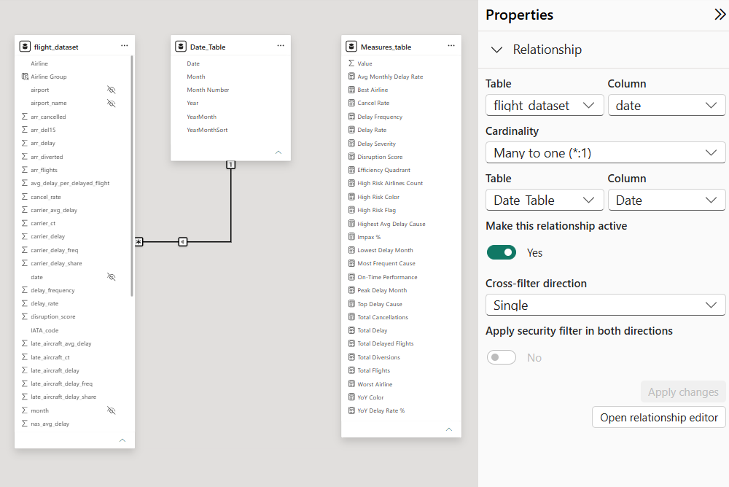
Data Model (Power BI)
Primary dataset dimensions – 171426 * 43
Measures – 26
Additional date table for time series aggregation and sorting purposes

Slide 22
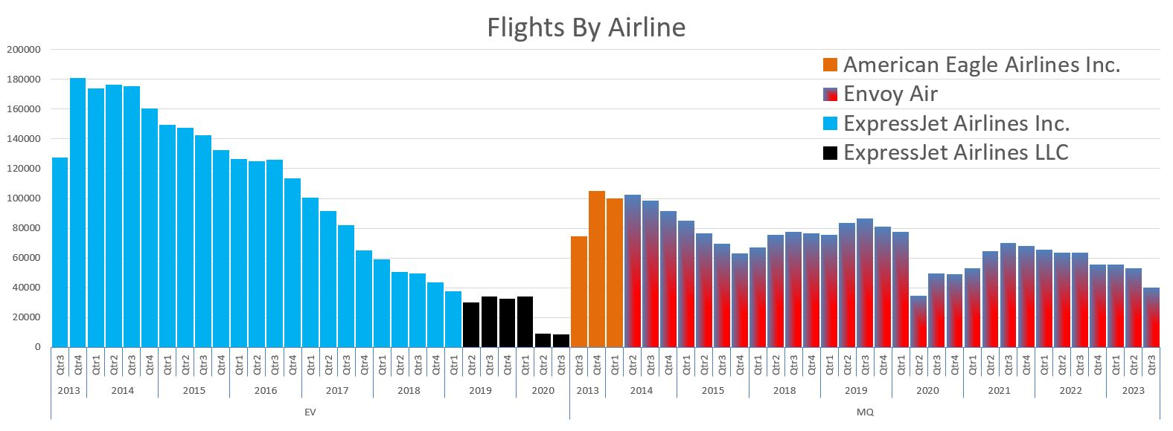
Carrier Name Changes Over Time
23 distinct carrier names present in the dataset.
Only 21 unique IATA carrier codes existed.
Two airlines changed their operating names while retaining the same carrier code:
EV → ExpressJet Airlines Inc. → ExpressJet Airlines LLC
MQ → American Eagle Airlines Inc. → Envoy Air

Slide 23
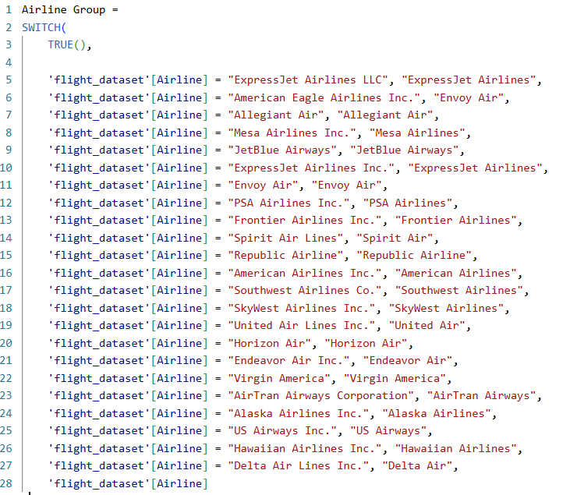
Airline Name Standardization
Created an Airline Group calculated column in Power BI.
Improved accuracy of airline comparisons.
Preserved historical continuity after airline rebranding.

Slide 24
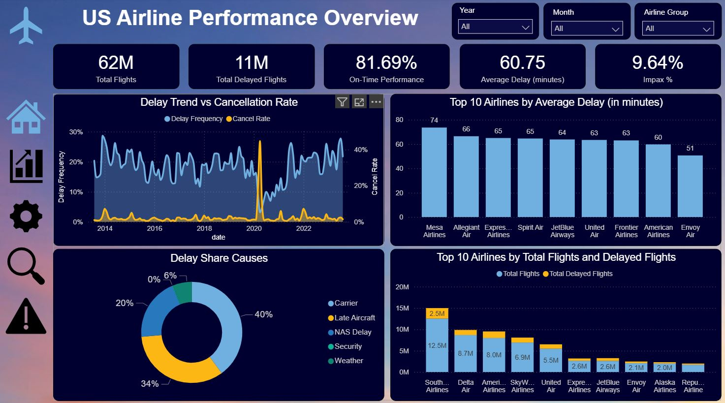
Overall Airline Performance Overview

Slide 25
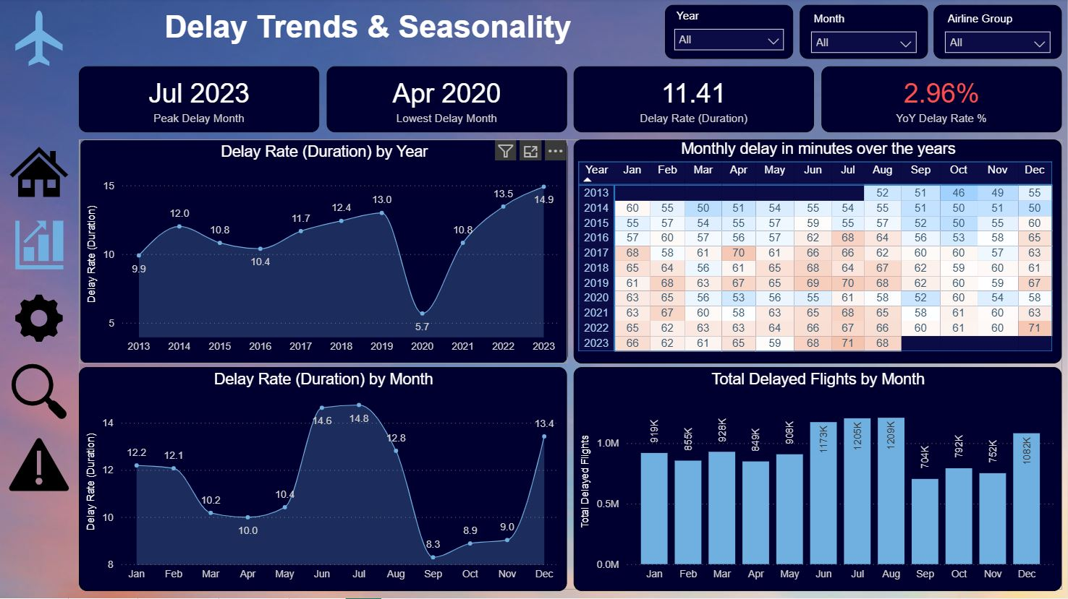
How Delays Change Over Time

Slide 26
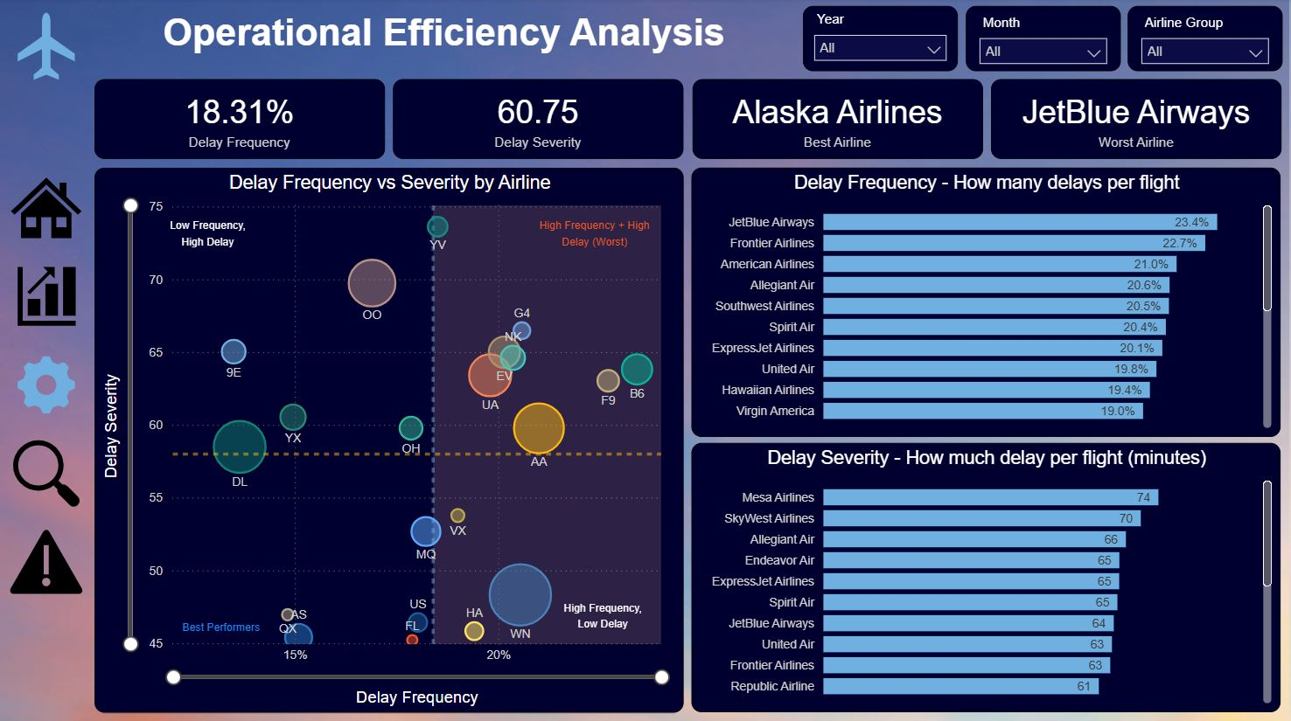
Frequency vs Severity of Delays

Slide 27
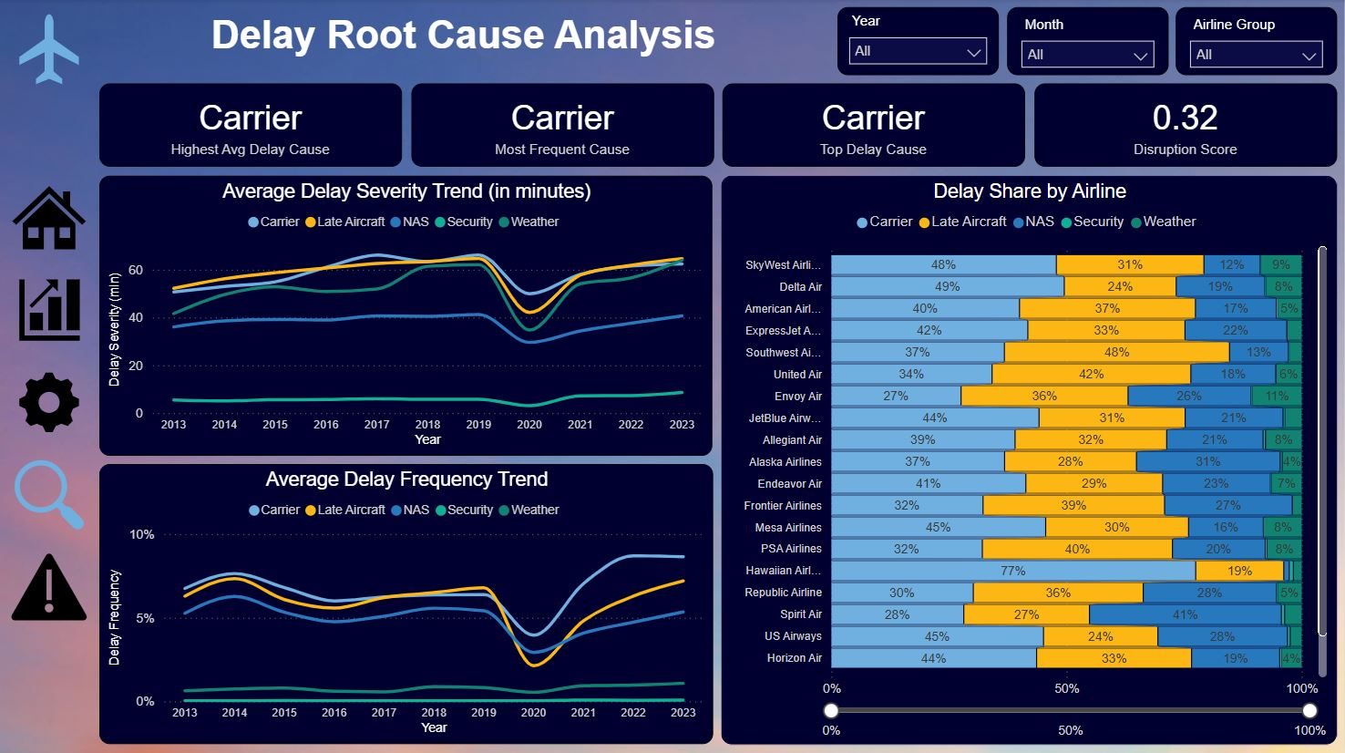
What Causes Delays?

Slide 28
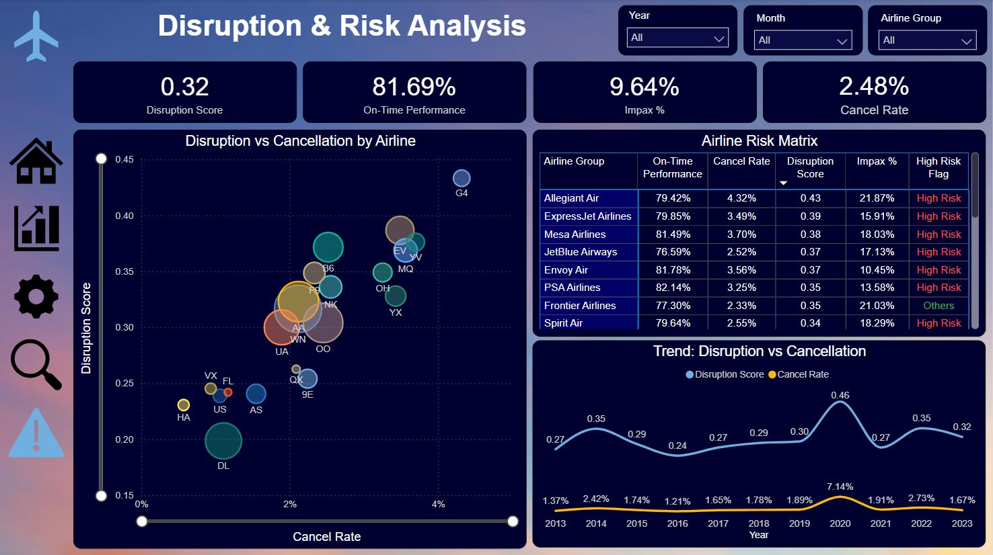
Risk-Based Airline Performance Assessment

Slide 29
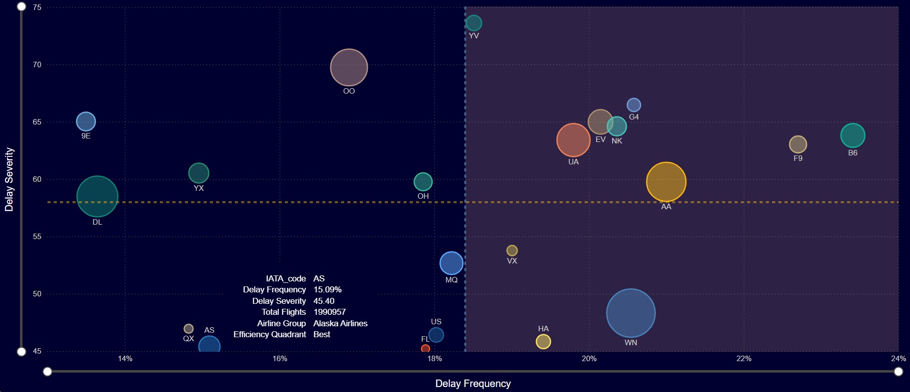
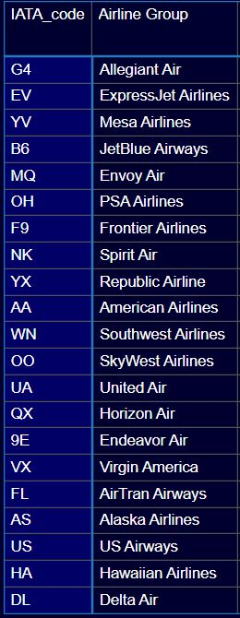
Efficiency Matrix

Slide 30
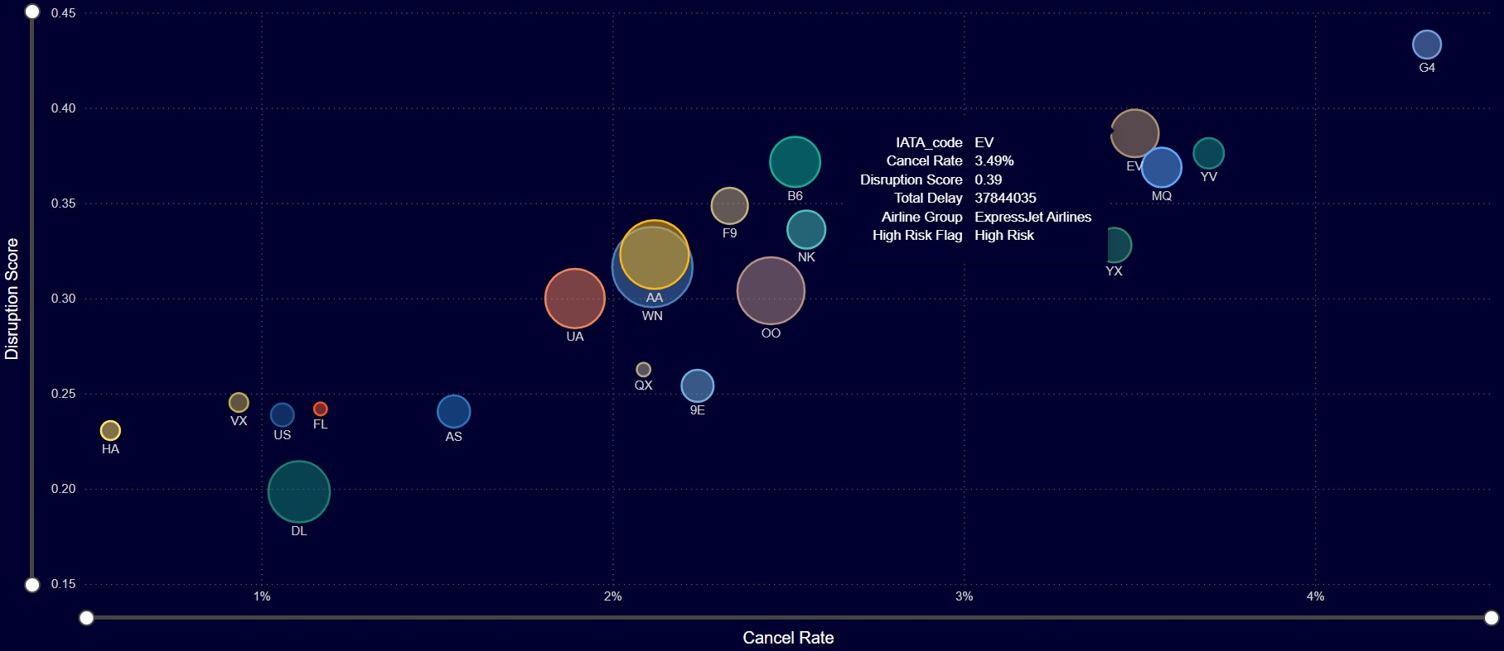
Disruption Matrix

Slide 31
Key Business Insights
Carrier-related delays are the biggest contributor
Delay behaviour is highly seasonal
Airlines differ in frequency vs severity
OTP alone is insufficient for evaluation
KPI-based assessment gives better operational visibility

Slide 32
DAX Measures Dictionary
Measure Name | Purpose | Definition / Formula
Avg Monthly Delay Rate | Trend analysis | Average delay rate by month
Best Airline | Ranking | Airline with lowest disruption
Cancel Rate | Efficiency KPI | Cancelled Flights ÷ Total Flights
Delay Frequency | Frequency KPI | Delayed Flights ÷ Total Flights
Delay Rate | Severity KPI | Delay Minutes ÷ Flights
Delay Severity | Severity KPI | Average delay per delayed flight
Disruption Score | Risk KPI | Weighted disruption metric
Efficiency Quadrant | Segmentation | Airline classification using frequency vs severity
High Risk Airlines Count | Risk monitoring | Count of high-risk airlines
High Risk Color | Conditional formatting | Color logic for risk visuals
High Risk Flag | Risk classification | Flags airlines as high/low risk
Highest Avg Delay Cause | Root cause analysis | Largest severity contributor
Impax % | Passenger impact KPI | (Severe Delays + Cancellations) ÷ Flights
Lowest Delay Month | Time intelligence | Month with lowest delays

Slide 33
DAX Measures Dictionary
Measure Name | Purpose | Definition / Formula
Most Frequent Cause | Root cause analysis | Highest delay frequency cause
On-Time Performance | OTP KPI | On-Time Flights ÷ Total Flights
Peak Delay Month | Time intelligence | Month with highest delays
Top Delay Cause | Root cause analysis | Dominant delay contributor
Total Cancellations | Volume metric | Sum of cancelled flights
Total Delay | Volume metric | Sum of delay minutes
Total Delayed Flights | Volume metric | Sum of delayed flights
Total Diversions | Volume metric | Sum of diverted flights
Total Flights | Volume metric | Sum of arriving flights
Worst Airline | Ranking | Airline with highest disruption
YoY Color | Conditional formatting | Color logic for YoY trend
YoY Delay Rate % | Time intelligence | Year-over-year delay change %

Slide 34
Future Scope
Airport-level performance analysis
Route-level and flight-level analysis
Passenger, revenue, and cost impact analysis
Predictive modelling and forecasting

Slide 35




Thanks

